Slide 1

Java OOP
Course Introduction
SoftUni Team
Technical Trainers
Software University
https://softuni.bg/

Slide 2
Table of Contents
Diamond Partners
Course Objectives & Program
The Trainers Team
Course Organization
Homework
Exam
Resources

Slide 3













SoftUni Diamond Partners

Slide 4

Course Objectives

Slide 5
Why OOP?
Object-oriented programming is an important paradigm
Anyone involved in software development should be familiar with OOP and OO modelling
All modern languages are either object-oriented or support classes and objects
Modern frameworks, libraries and APIs are object-oriented
OOP is a basic requirement for starting a job as developer
5

Slide 6
Course Topics
Working with Abstraction
Encapsulation
Inheritance
Interfaces and Abstraction
Polymorphism
SOLID
Reflection and Annotations
Workshop: Exceptions and Error Handling
Unit Testing
Test Driven Development
Design Patterns

Slide 7

The Trainers Team

Slide 8
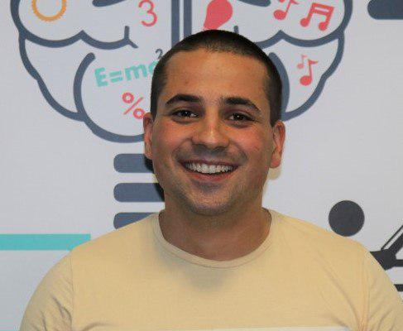
Martin Paunov
Java Developer at Virtual Racing School
Experience with Java, C++, C#
Technical Trainer @ SoftUni
Interested in Astrophysics

Slide 9
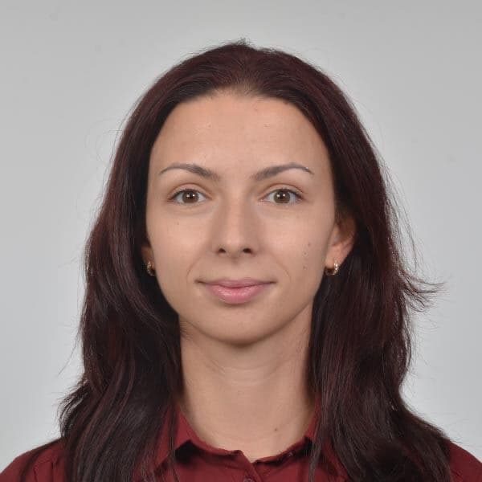
Lora Georgieva
Android Developer @ Imperia Online
Technical Trainer @ SoftUni
Chemical Engineering at University of Chemical Technology and Metallurgy
Experience in Java and Kotlin

Slide 10
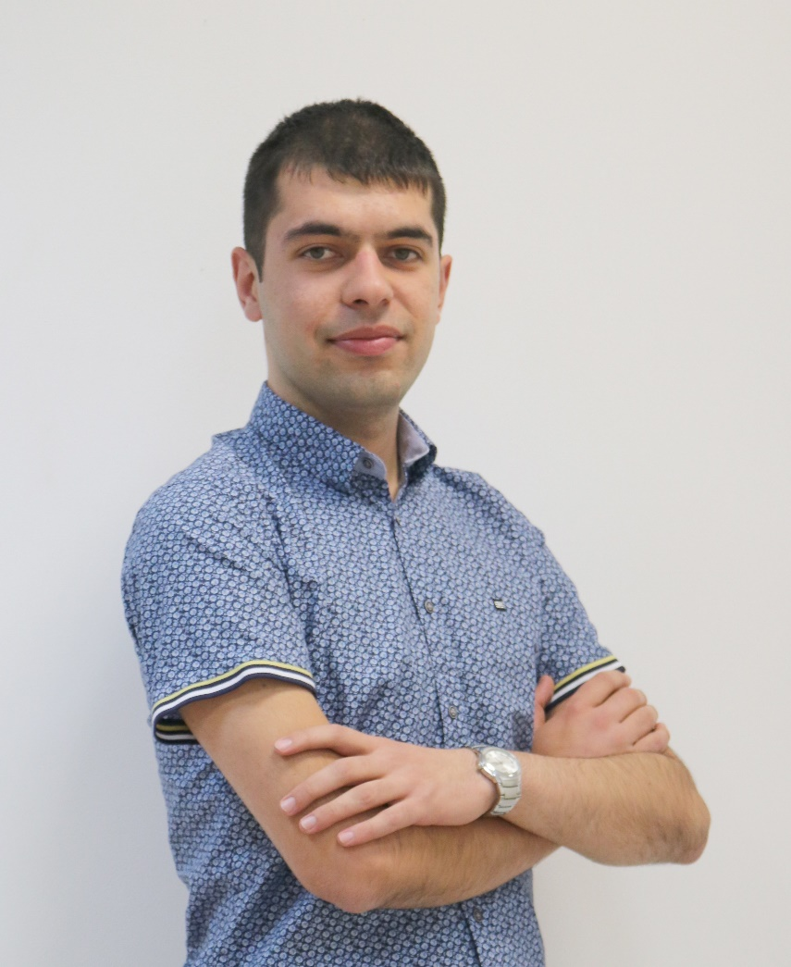
Lyubomir Tomanov
Java Developer @ PremFina
Technical Trainer @ SoftUni
Applied Mathematics and Informatics at Technical university of Sofia
Experience in Java and JavaScript

Slide 11

Course Organization

Slide 12
Course Information
7 weeks / 4 times a week
15 Credits
Time frame
23 February 2021 – 10 April 2021
Exams
Theoretical: 10 April 2021
Practical: 10 April 2021
Theoretical (Retake): 18 April 2021
Practical (Retake): 18 April 2021
12

Slide 13

Homework Assignments & Exercises
Your homework is mainly work in class
Lesson days → slides + live demos + exercises
Exercise days → only exercises
How to submit your homework?
Submitted in the judge system
Do your homework when it's due
Assignments pile up quickly

Slide 14


Scoring System for the Course
Theoretical Exam 5%
PracticalExam 95%
Evaluation
Homework 5 %
14

Slide 15
Practical Exam
2 practical problem for 4 hours
Create a simple project
Following the OOP principles
Implement functionality based on the description
Test a provided class
Automated judge system with real-time feedback
Upload a zip project to the judge system
15

Slide 16
Theoretical Exam
30 minutes
Multiple-choice with 1 or more correct answer
English
Automated quiz system
Available online on the day of the practical exam
You can submit your answers just one time
16

Slide 17

Resources

Slide 18



Course Web Site, Forum and FB Group
Official web site:
Official discussion forum:
Official Facebook groups:
Community Facebook group:
https://softuni.bg/trainings/3216/java-oop-february-2021
https://softuni.bg/forum/categories/69/module-java-advanced
https://www.facebook.com/groups/javaadvancedjanuary2021
https://www.facebook.com/groups/SoftUniJavaCommunity/

Slide 19


Learn to Search in Internet
The course assignments require to search in Internet
This is an important part of the learning process
Some exercises intentionally have no hints
Learn to find solutions!
Software development includes everyday searching and learning
No excuses, just learn to study!
Developers learn new technologies, tools, languages every day!

Slide 20
Trainings @ Software University (SoftUni)
Software University – High-Quality Education, Profession and Job for Software Developers
softuni.bg
Software University Foundation
softuni.foundation
Software University @ Facebook
facebook.com/SoftwareUniversity
Software University Forums
forum.softuni.bg
20
Notes:
20

Slide 21

License
This course (slides, examples, demos, exercises, homework, documents, videos and other assets) is copyrighted content
Unauthorized copy, reproduction or use is illegal
© SoftUni – https://about.softuni.bg
© Software University – https://softuni.bg
Notes:
21

